Slide 1
Functions, Classes, and Objects
Week 1, Day 2

Slide 2
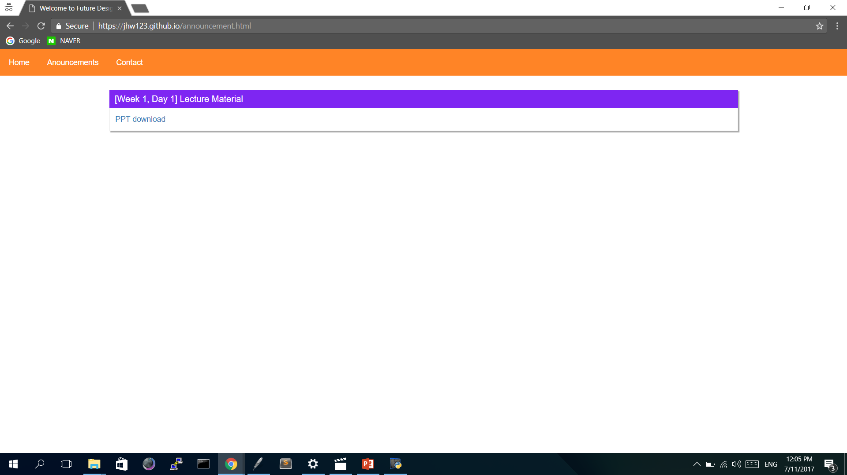
Announcements
Culture Class will be detailed later
Lectures will be uploaded onto the Class Website:
jhw123.github.io

Slide 3
Last time...
We explored programming, computational thinking, and hubo
What is:
Programming
Computational thinking
Function definition

Slide 4
Today...
Functions, Classes, and Objects
Bugs and Errors
Writing code
Solving real world problems with hubo
Help him collect beepers!

Slide 5
Class
We are a class:
Who is in our class?
What do each of us do?
Template for creating objects
Two things are needed:
Variables
Methods

Slide 6
Variables
A name/placeholder/storage for a value
Should have a name
Example:
Equal sign assigns
Value
Name

Slide 7
Methods
The behavior of an object
What does hubo do?
Answer: Walk forward and turn left
Namely, a function
Hubo and his girlfriend Amy

Slide 8
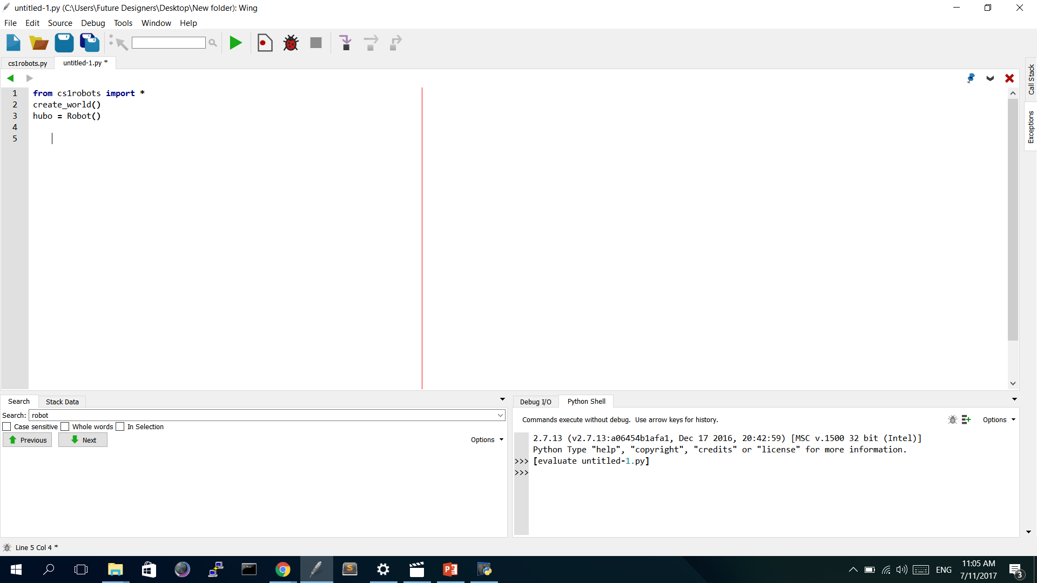
Creating hubo
Click!

Slide 9
Things to Remember
Hubo begins at (1, 1)
Hubo faces EAST
The world is 10 by 10
Hubo can only move forward and turn left

Slide 10
Hubo

Slide 11
Let’s make hubo walk!
We want him to walk around and come back to his position
Let’s write the code for this

Slide 13
But…
The code becomes too long.
Let’s simplify it!
How would we simplify it?

Slide 14
Functions
A block of organized, reusable code for a single action
Ex) How does hubo turn right?
Answer: hubo.turn_left three times

Slide 15
Function definition

Slide 16
Functions
A block of organized, reusable code for a single action
Ex) How does hubo turn right?
Answer: hubo.turn_left three times

Slide 17
Simplified Code

Slide 18
Objects
A type of a job-holder
Hubo is an object
It has properties expressed through its variables and methods that perform a certain task
Example:
Variables: Height, age, clothes, grade, favorite color, favorite movie
Methods: Sleep, walk, eat, wash face, wear clothes, etc

Slide 19
Example of a class
Class name
Comments
Constructor
Parameters
Variables
Return statement

Slide 20
Sytantics
Specific writing style for the programming language
Parentheses, Colons, and Indentations
Variable Name Convention
Must begin with a letter or an underscore (_)
The rest can consist of letters, numbers, or underscores
Case Sensitive
O _name, Ethiopia, num_3 X 300people, #hello

Slide 21
Uh oh, bugs!
Any errors in the program
Originated from actual bugs
Getting rid of the bugs is called debugging

Slide 22
Types of Bugs
Syntax - Problem in the writing
Running - Problem in the running
Semantic - Problem in the algorithm/solution
It usually becomes more and more difficult to fix in the order of:
Syntax < Running < Semantic

Slide 23
Compiling/Running
Compiling
Translates code so that the computer can understand it
Will catch any syntax errors
Running
Executes the program
Will stop running if there is an error
Ex) Hubo runs into a wall

Slide 24
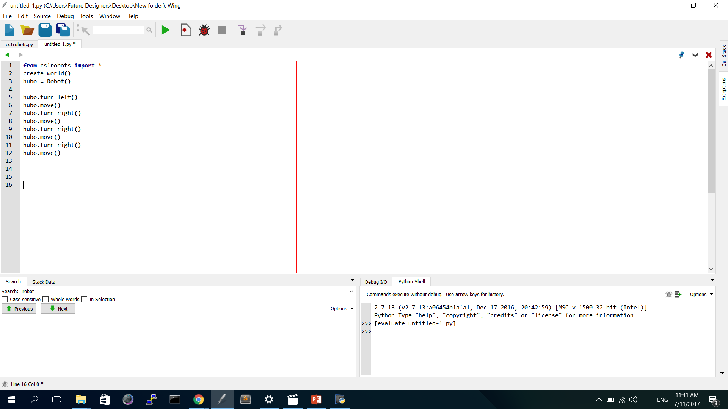
Compiling/Running
When you click on this, it compiles and runs the program
Error or Lines appear here

Slide 25
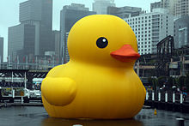
Good tips!
When naming variables, use consistent and related names
Always. Comment.
Use #
When debugging, go step by step
Rubber duck debugging!

Slide 26
Lab Session
Week 1, Day 2

Slide 27
Python
We will be using:
Python version 2.7
Wing IDE

Slide 28
How to Open Wing IDE
Click
Type in “Wing IDE”

Slide 29
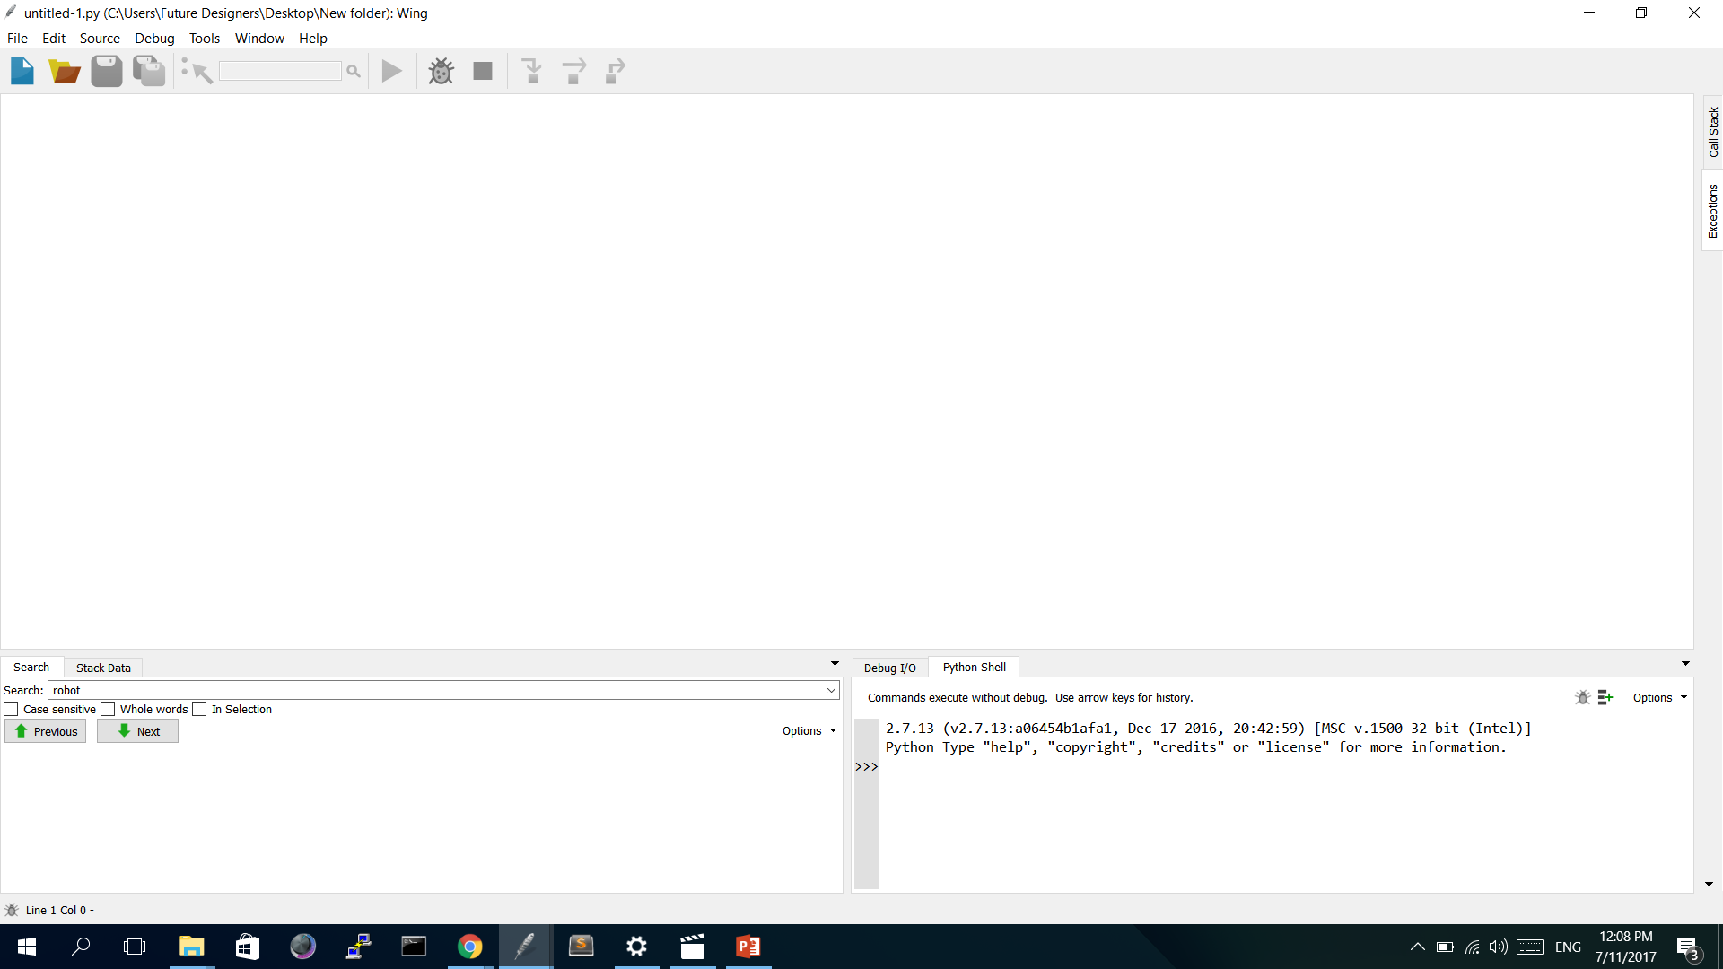
Wing IDE

Slide 30
Creating a new Python file
Click
OR
Click

Slide 31
Saving the file
Change to Desktop
Click!
Rename

Slide 32
Traveling through the world
Create a list of steps
hubo.move()
hubo.turn_left()
Explore the world! (5 min)

Slide 33
Task 1 - ZigZag

Slide 34
Task 2 - Hurdle

Slide 35
Methods Required
hubo.pick_beeper() : hubo picks up beepers
Define the following:
def jump_hurdle()

Slide 36
Good Tips!
Great methods to use:
hubo.set_trace(“COLOR”) : Color can be BLUE, YELLOW, etc
hubo.set_pause(delay_time) : 0 < time < 2
Create functions and use them
Rubber Duck Programming
SAVE often!

Slide 37
Challenge: Unknown Maze
What if the maze is unknown?
An algorithm is needed
Hint: think of the three different cases hubo can face

Slide 38
Next time…
Variables
Objects
More Hubo!
Using numbers

